Slide 1
Natural Language
Processing

Slide 2
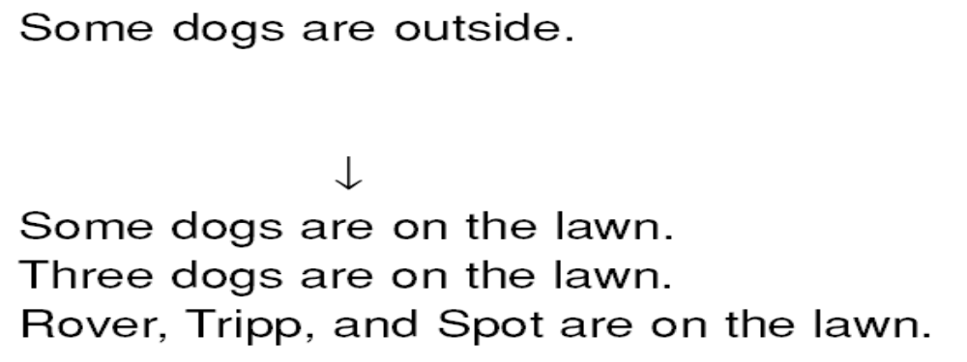
Features of Language That Make It Both Difficult and Useful
The Problem: English sentences are incomplete descriptions of the information that they are intended to convey:
The Good Side: Language allows speakers to be as vague or as precise as they like. It also allows speakers to leave out things they believe their hearers already know.

Slide 3
Features of Language That Make It Both Difficult and Useful
The Problem: The same expression means different things in different contexts:
Where’s the water? (in a chemistry lab, it must be pure)
Where’s the water? (when you are thirsty, it must be potable)
Where’s the water? (dealing with a leaky roof, it can be filthy)
The Good Side: Language lets us communicate about an infinite world using a finite (and thus learnable) number of symbols.

Slide 4
Features of Language That Make It Both Difficult and Useful
The Problem: No natural language program can be complete because new words, expressions, and meanings can be
generated quite freely:
I’ll fax it to you.
The Good Side: Language can evolve as the experiences that we want to communicate about evolve.

Slide 5
Features of Language That Make It Both Difficult and Useful
The Problem: There are lots of ways to say the same thing:
Mary was born on October 11.
Mary’s birthday is October 11.
The Good Side: When you know a lot, facts imply each other. Language is intended to be used by agents who know a lot.

Slide 6
Steps in Natural Language Understanding
• Morphological Analysis—Individual words are analyzed into their components, and nonword tokens, such as punctuation, are separated from the words.
• Syntactic Analysis—Linear sequences of words are transformed into structures that show how the words relate to each other. Some word sequences may be rejected if they violate the language’s rules for how words may be combined. For example, an English syntactic analyzer would reject the sentence “Boy the go the to store.”
• Semantic Analysis—The structures created by the syntactic analyzer are assigned meanings. In other words, a mapping is made between the syntactic structures and objects in the task domain. Structures for which no such mapping is possible may be rejected. For example, in most universes, the sentence “Colorless green ideas sleep furiously” [Chomsky, 1957] would be rejected as semantically anomolous.
• Discourse Integration—The meaning of an individual sentence may depend on the sentences that precede it and may influence the meanings of the sentences that follow it. For example, the word “it” in the sentence, “John wanted it,” depends on the prior discourse context, while the word “John” may influence the meaning of later sentences (such as, “He always had.”)
• Pragmatic Analysis—The structure representing what was said is reinterpreted to determine what was actually meant. For example, the sentence “Do you know what time it is?” should be interpreted as a request to be told the time.

Slide 7
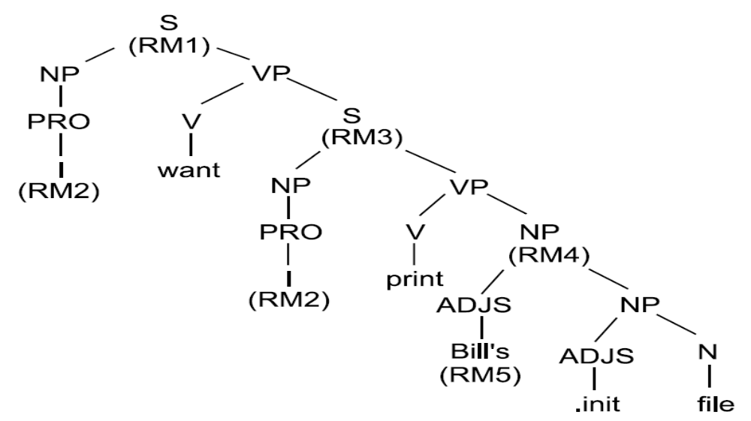
The Result of Syntactic Analysis of “I want to print Bill’s .init file.”

Slide 8
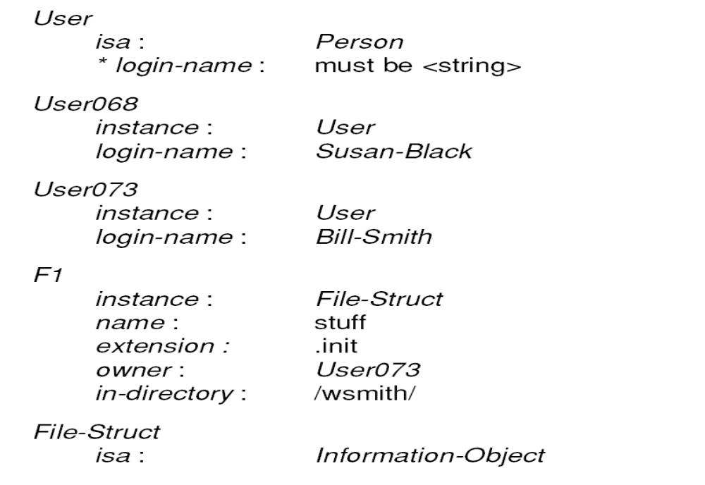
A Knowledge Base Fragment

Slide 9
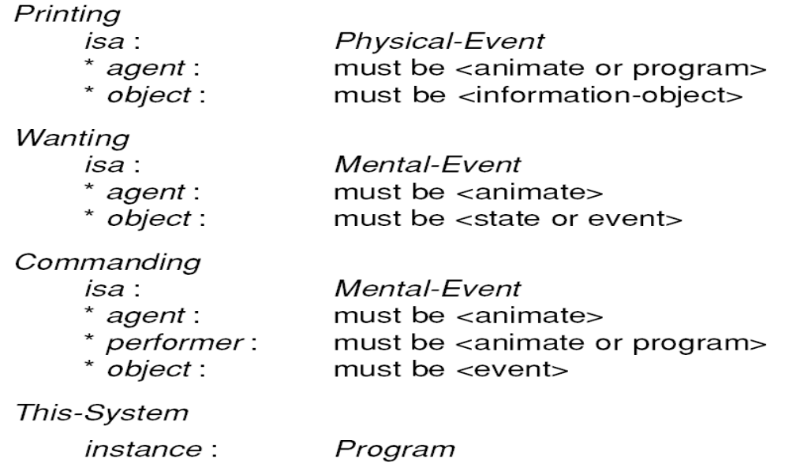
A Knowledge Base Fragment (Cont’d

Slide 10
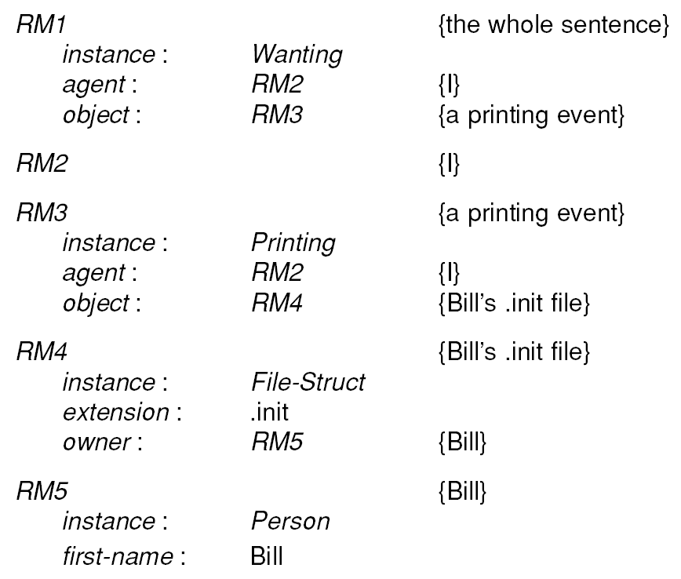
The Result of Semantic Analysis of
“I want to print Bill’s .init file.”

Slide 11
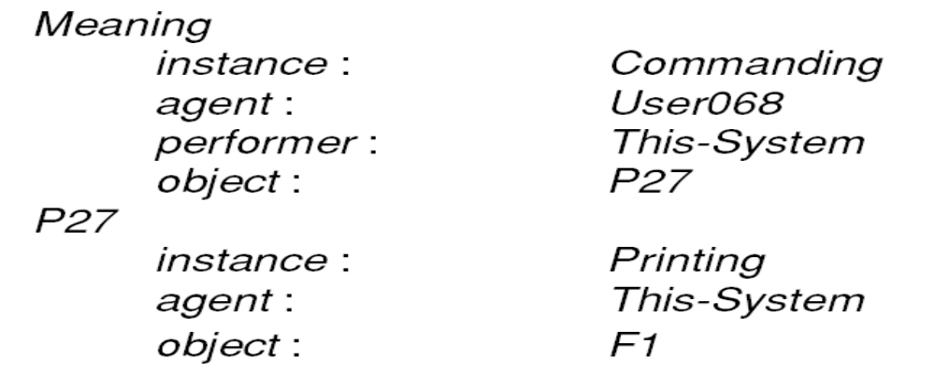
The Result of Semantic Analysis of
“I want to print Bill’s .init file.”
This lead to the final result :
lpr /wsmith/stuff.init

Slide 12
Syntactic Processing
Semantic processing must operate on sentence constituents. If there is no syntactic parsing step, then the semantics system must decide on its own constituents. If parsing is done, on the other hand, it constrains the number of constituents that semantics can consider. Syntactic parsing is computationally less expensive than is semantic processing (which may require substantial inference). Thus it can play a significant role in reducing overall system complexity.
• Although it is often possible to extract the meaning of a sentence without using grammatical facts, it is not always possible to do so. Consider, for example, the sentences
– The satellite orbited Mars.
– Mars orbited the satellite.
In the second sentence, syntactic facts demand an interpretation in which a planet (Mars) revolves around a satellite, despite the apparent improbability of such a scenario. Although there are many ways to produce a parse, almost all the systems that are actually used have two main components:
• A declarative representation, called a grammar, of the syntactic facts about the language
• A procedure, called a parser, that compares the grammar against input sentences to produce parsed structure

Slide 13
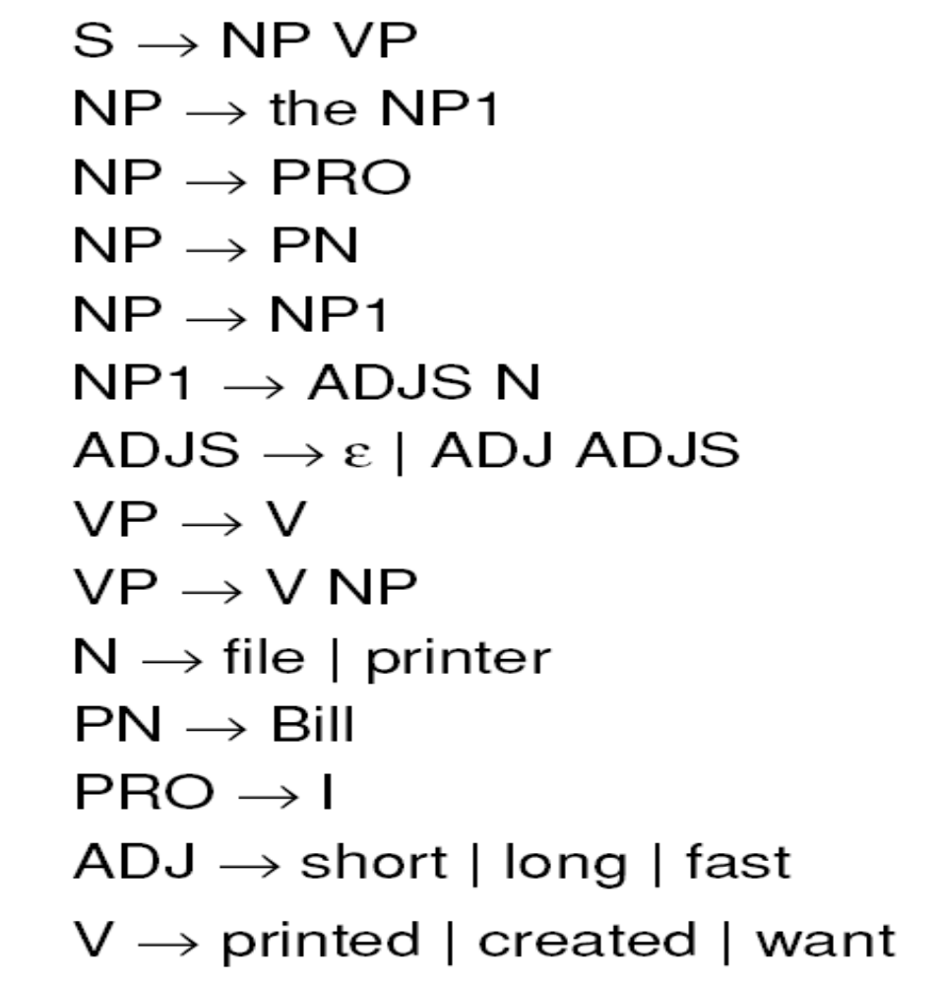
A Simple Grammar for a
Fragment of English

Slide 14
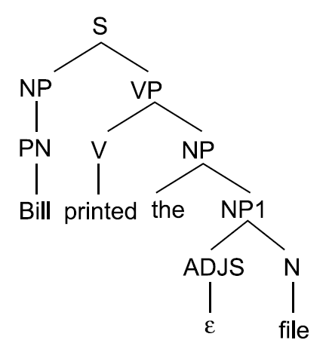
A Parse Tree for a Sentence

Slide 15
Ambiguity
Examples :
“Have the students who missed the exam take it today.”
“Have the students who missed the exam taken it today?”
“The horse raced past the barn fell down.”

Slide 16
Parsing Strategies
Top-Down
Bottom-Up
All Paths
Best Path with Backtracking
Best Path with Patch up
Wait and See

Slide 17
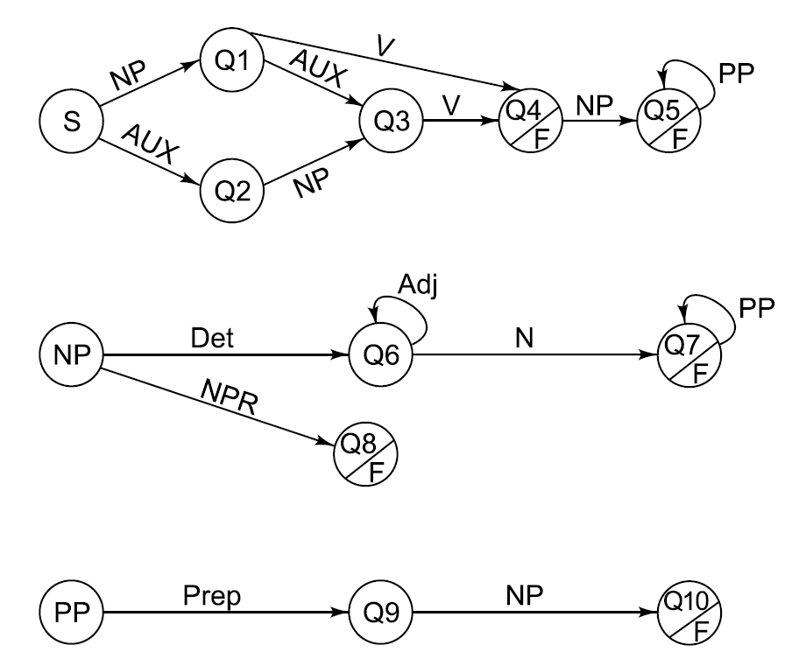
An ATN Network for a
Fragment of English

Slide 18
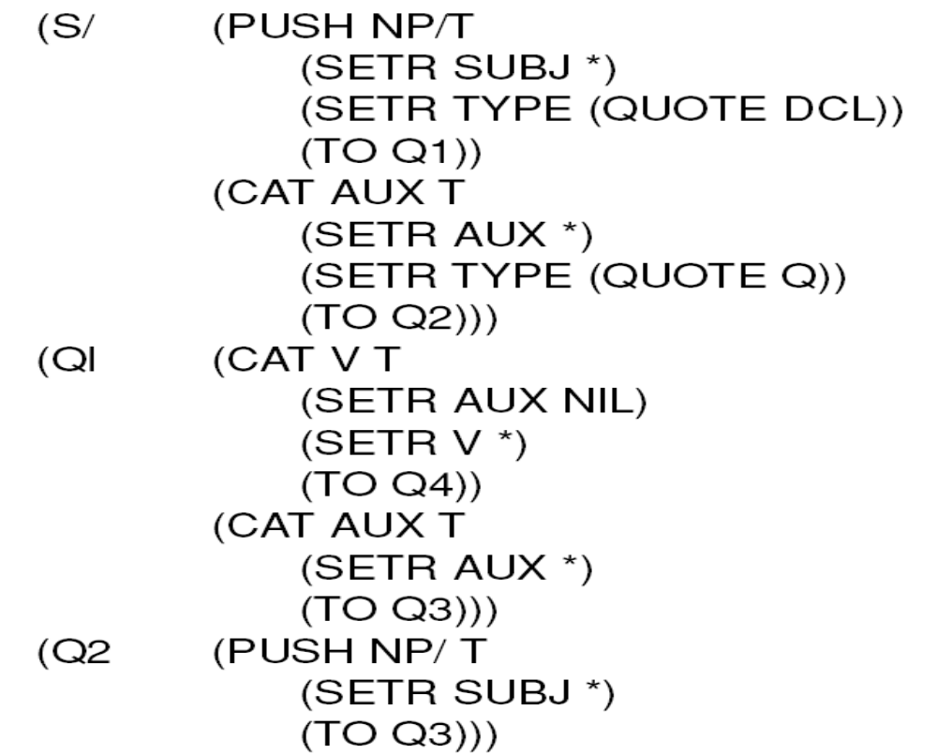
An ATN Grammar in List Form

Slide 19
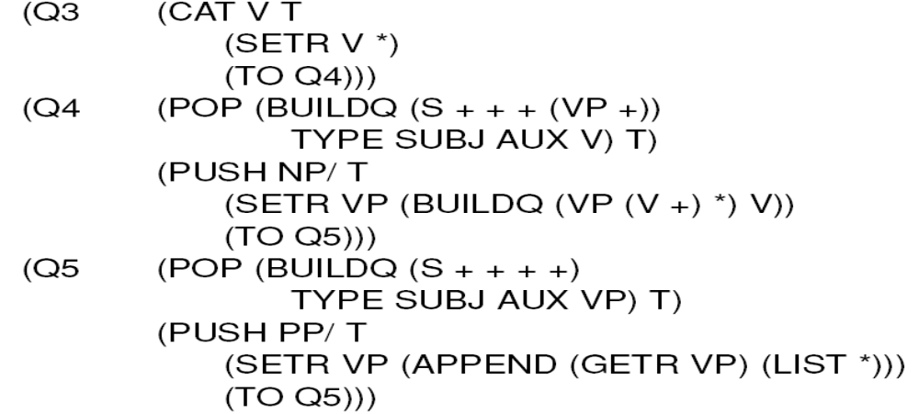
An ATN Grammar in List Form (Cont’d)

Slide 20
Unification Grammars
Purely declarative representations.
Unification simultaneously performs two operations :
Matching
Structure building, by combining constituents
Think of graphs as sets not lists, i.e., order doesn’t matter.

Slide 21
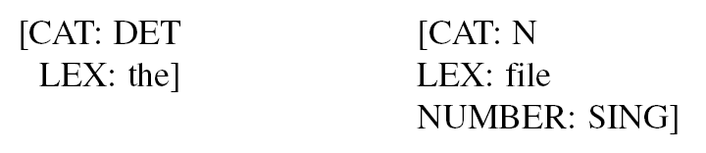
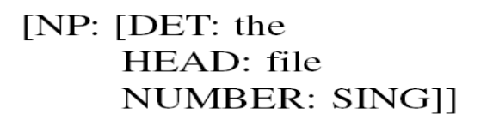

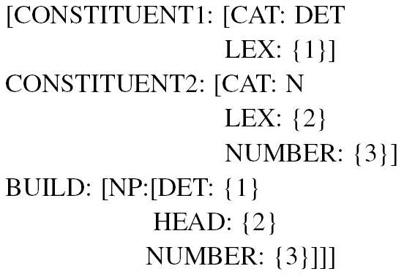
Unification Grammars
Lexical items as graphs :
Nonterminal constituents as graphs :
Grammar rules (e.g., ) as graphs :

Slide 22
Algorithm : Graph - Unify
1. If either G1 or G2 is an attribute that is not itself an attribute-value pair then:
(a) If the attributes conflict (as defined above), then fail.
(b) If either is a variable, then bind it to the value of the other and return that value.
(c) Otherwise, return the most general value that is consistent with both the original values. Specifically, if disjunction is allowed, then return the inter section of the values.
2. Otherwise, do:
(a) Set variable NEW to empty.
(b) For each attribute A that is present (at the top level) in either G1 or G2 do
(i) If A is not present at the top level in the other input, then add A and its value to NEW.
(ii) If it is, then call Graph-Unify with the two values for A. If that fails, then fail. Otherwise, take the new value of A to be the result of that unification and add A with its value to NEW.
(c) If there are any labels attached to G1 or G2, then bind them to NEW and return NEW.

Slide 23
Semantic Analysis
Lexical processing
Word sense disambiguation using features such as:
• PHYSICAL-OBJECT
• ANIMATE-OBJECT
• ABSTRACT-OBJECT
Examples :
“Pop hates the cold.”
“John saw Susan’s diamond shimmering from across the room.”
“My lawn hates the cold.”
Word sense disambiguation using reasoning.
Sentence processing
Semantic grammars
Case Grammars
Conceptual parsing
Approximately compositional semantic interpretation.

Slide 24
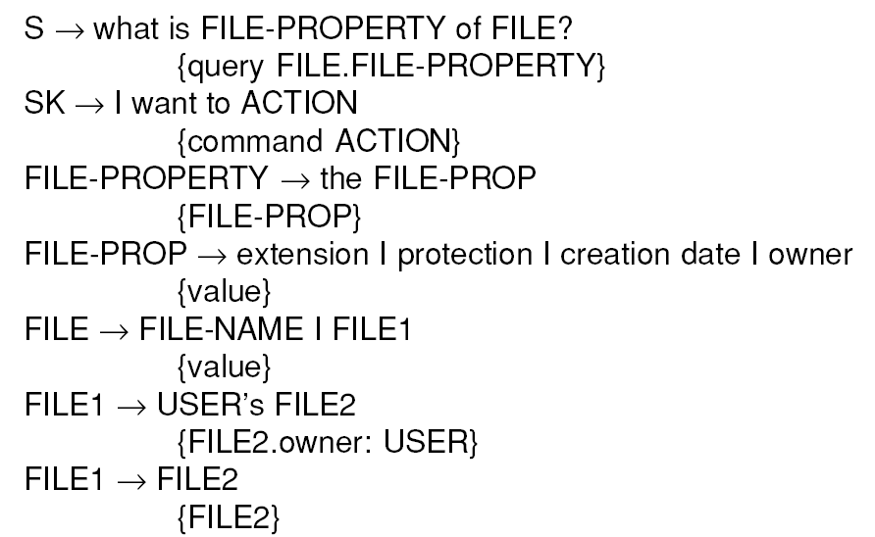
A Semantic Grammar

Slide 25
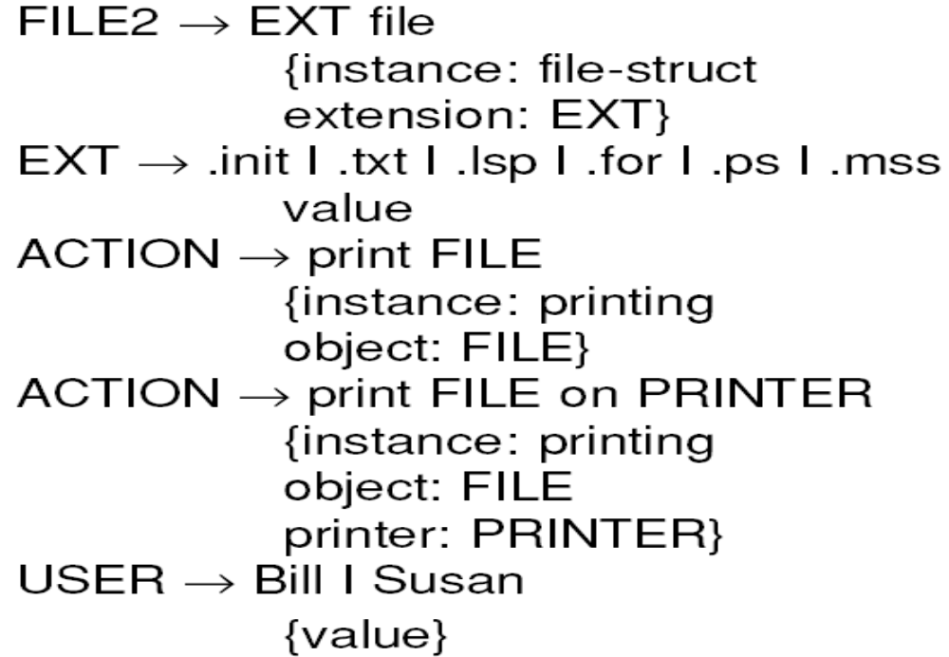
A Semantic Grammar (Cont’d)

Slide 26
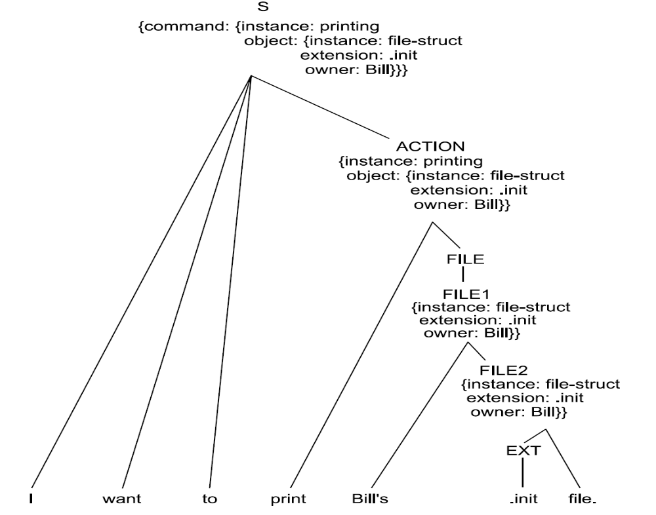
The result of Parsing with a
Semantic Grammar

Slide 27
Case Grammars
Case grammars capture surface semantic roles.
Example :
• “Mother baked for three hours.”
(baked (agent Mother)
(timeperiod 3-hours))
“The pie baked for three hours.”
(baked (object Pie)
(timeperiod 3-hours))

Slide 28
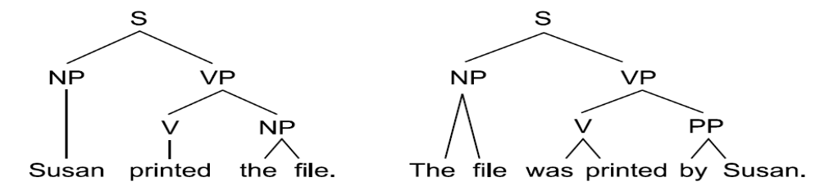
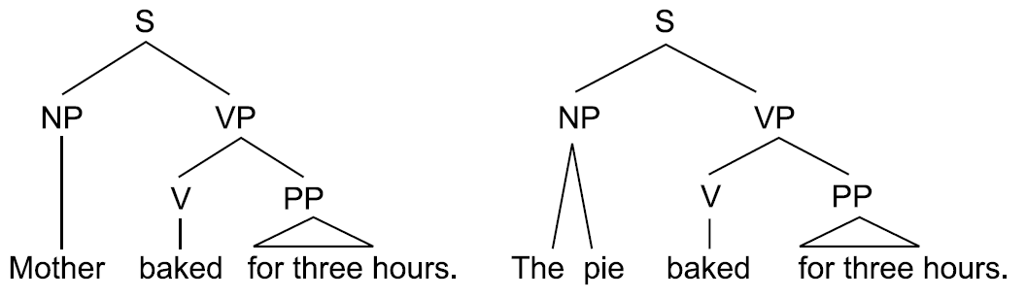
Syntactic Parses of Two
Similar Sentences
Syntactic Parses of an Active and a Passive Sentences

Slide 29
Case Grammar
(A) Agent—Instigator of the action (typically animate)
(I) Instrument—Cause of the event or object used in causing the event (typically inanimate)
(D) Dative—Entity affected by the action (typically animate)
(F) Factitive—Object or being resulting from the event
(L) Locative—Place of the event
(S) Source—Place from which something moves
(G) Goal—Place to which something moves
(B) Beneficiary—Being on whose behalf the event occurred (typically animate)
(T) Time—Time at which the event occurred
(O) Object—Entity that is acted upon or that changes, the most general case

Slide 30
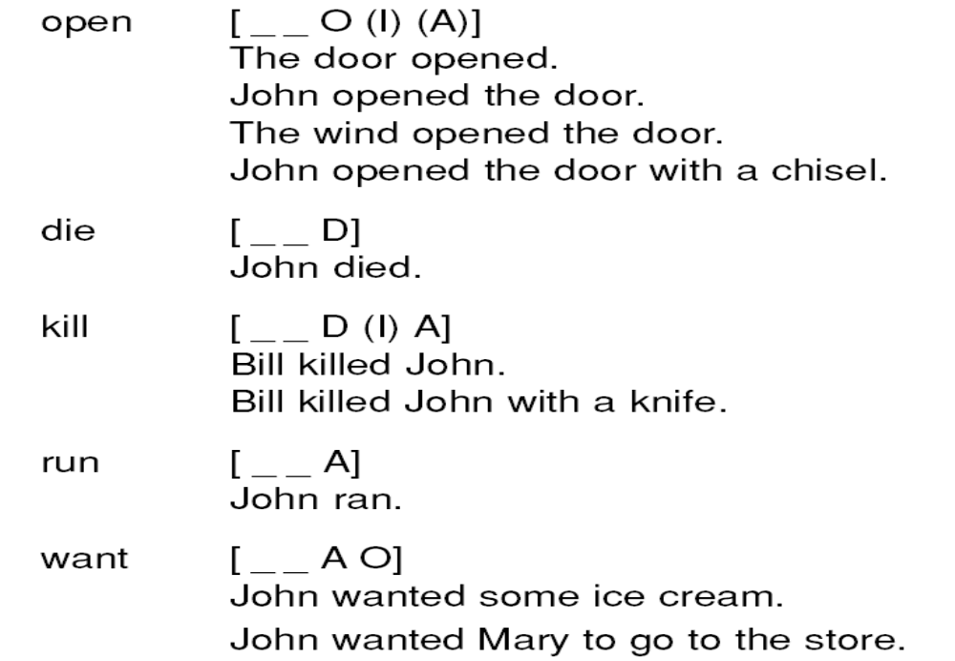
Some Verb Case Frames

